Slide 1
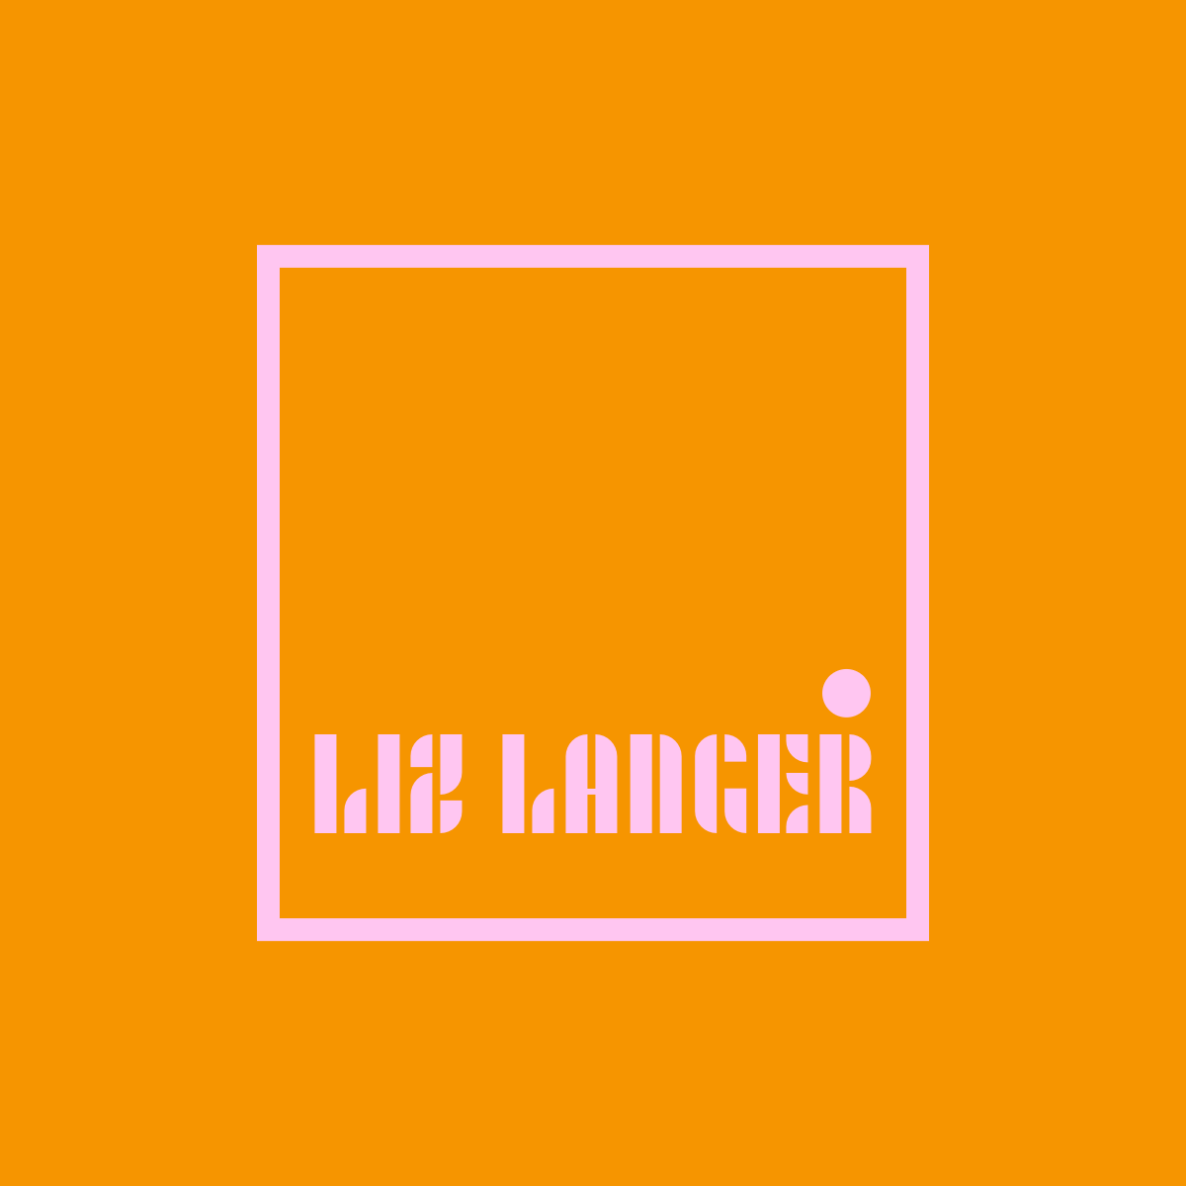

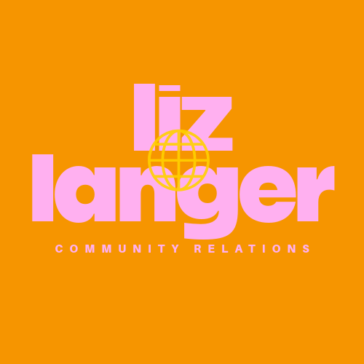
A UX Design Study
By Liz Langer

Slide 2
The UX Research Method
The Purpose of the UX Research
The UX Research Method is a study conducted by designers to understand user behaviors, needs, and motivators.
It takes place by asking a series of questions about certain designs to a group of people.
It is the act of gaining consumer feedback.
The purpose of this Method is to help best understand consumer needs.
This research is often seen when designing a new website or web-based product for everyday consumer use.
The purpose is be able to design the most effective and user friendly version of a product.

Slide 3
Chloe S.
Allison H.
Mandy W.
The Participants
Age: 20
Gender: Female
Occupation: Sophomore Duquesne Student
Area of Study: Mass Media & Design Focus studies
Age: 20
Gender: Female
Occupation: Sophomore Penn State Student
Area of Study: Engineering
Age: 19
Gender: Female
Occupation: Sophomore Kent State Student
Area of Study: Nursing

Slide 4
Chloe S.
Allison H.
Mandy W.
The Participants’ Thoughts
Liked all the designs.
Wished some had a little more contrast and clarity.
Overall, enjoyed the aesthetics.
Enjoyed all the designs.
Felt there was a lack of context in terms of my brand.
Overall, liked the content, but needed more information.
Did not like the design colors.
Enjoyed the different approach to a simple design.
Overall, enjoyed the concept, but suggested a different approach.

Slide 5
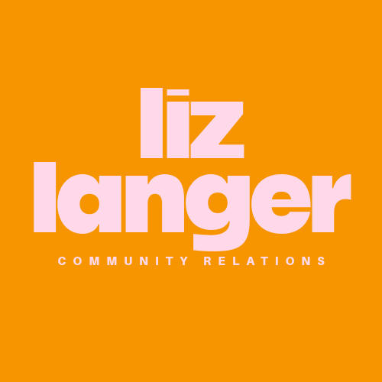
The Final Logo
After reviewing my interviewees’ feedback, I took the most liked logo and changed some of the features to create a more clear, contrasted, and diligent logo that represents me.

Slide 6
Appendix
ZOOM Transcripts
Transcript 1: Int. Writing and Design - Logo - Chloe Transcript
Transcript 2: Int. Writing and Design - Logo - Allison Transcript
Transcript 3: Int. Writing and Design - Logo - Mandy Transcript
Interview Script: Int. Writing & Design - Test Script

